Slide 1
Visualizing Xamarin.Forms
Andy Lech
Lead Mobile Engineer, Golf Channel
@TheXamarinFiles
github.com/xamarinfiles

Slide 2
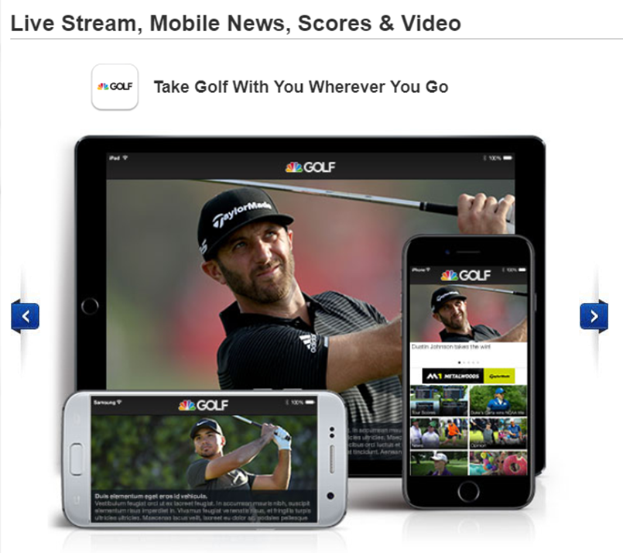
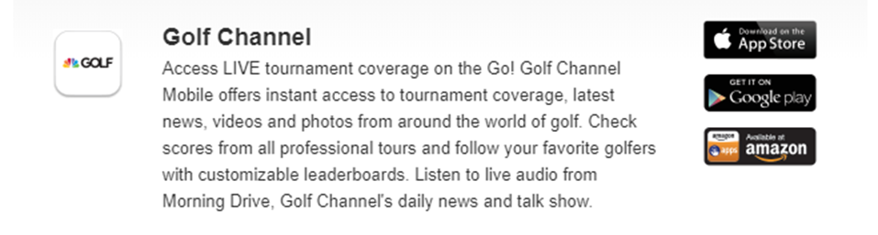
Golf Channel
Android phone/tablet app:
Android Studio
Java/Gradle
Apple phone/tablet app:
Xcode
Swift
www.golfchannel.com/mobile

Slide 3
Why Xamarin.Forms?
iOS C# UI
Android C# UI
Windows C# UI
Shared XAML/C# User Interface
Shared C# App Logic

Slide 4
New tools for laying out Xamarin.Forms XAML
Xamarin.Forms Previewer (Xamarin)
Xamarin Live Player (Xamarin)
LiveXAML (Ammy)
Gorilla Player (UXDivers)

Slide 5
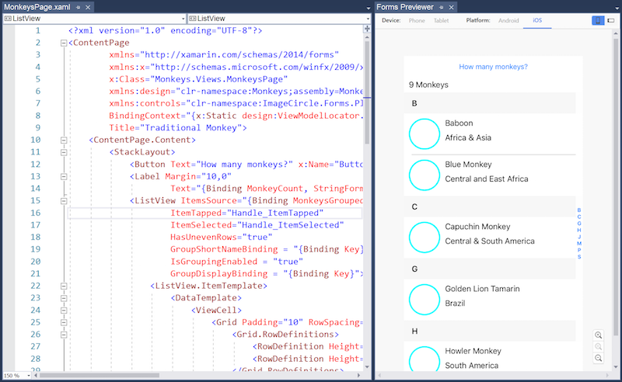
Xamarin.Forms Previewer
Previewed at last Xamarin Evolve (April 2016)
Released to stable in March 2017
Runs as a window inside Visual Studio
Doesn’t support base classes (events, etc.)
Design-time data:
Need to change architecture (add ViewModelLocator)
Need to add xmlns:design namespace to pages
Need to bind to a static ViewModel
Links:
XAML Previewer for Xamarin.Forms
Xamarin.Forms XAML Previewer Design Time Data
Xamarin Forms Visual Previewer
Notes:
Xamarin.Forms XAML Previewer Design Time Data
https://montemagno.com/xamarinforms-xaml-previewer-design-time-data/
Xamarin Forms Visual Previewer
https://xamarinhelp.com/xamarin-forms-previewer/
XAML Previewer for Xamarin.Forms
https://docs.microsoft.com/en-us/xamarin/xamarin-forms/xaml/xaml-previewer

Slide 6
Xamarin Live Player
Only available for Visual Studio 2017
Available in Google Play for Android
Available in preview for iOS through TestFlight
Involves pairing your devices with QR codes
Deploy to Live Player device in Visual Studio
Live Run Current View lets you see changes
Links:
Introducing Xamarin Live Player
Xamarin Live Player
Xamarin Live Player Samples

Slide 7
LiveXAML
Plug-in for Visual Studio 2015, 2017
Need to install LiveXAML NuGet packages
Multi-casting - attach debugger to each device
Trial version - projects with 3 or less XAML files
Paid license - $240 permanent, $24/month
Links:
LiveXAMl for Xamarin Forms
Visual Studio Extension
Ammy (XAML UI abstraction)

Slide 8
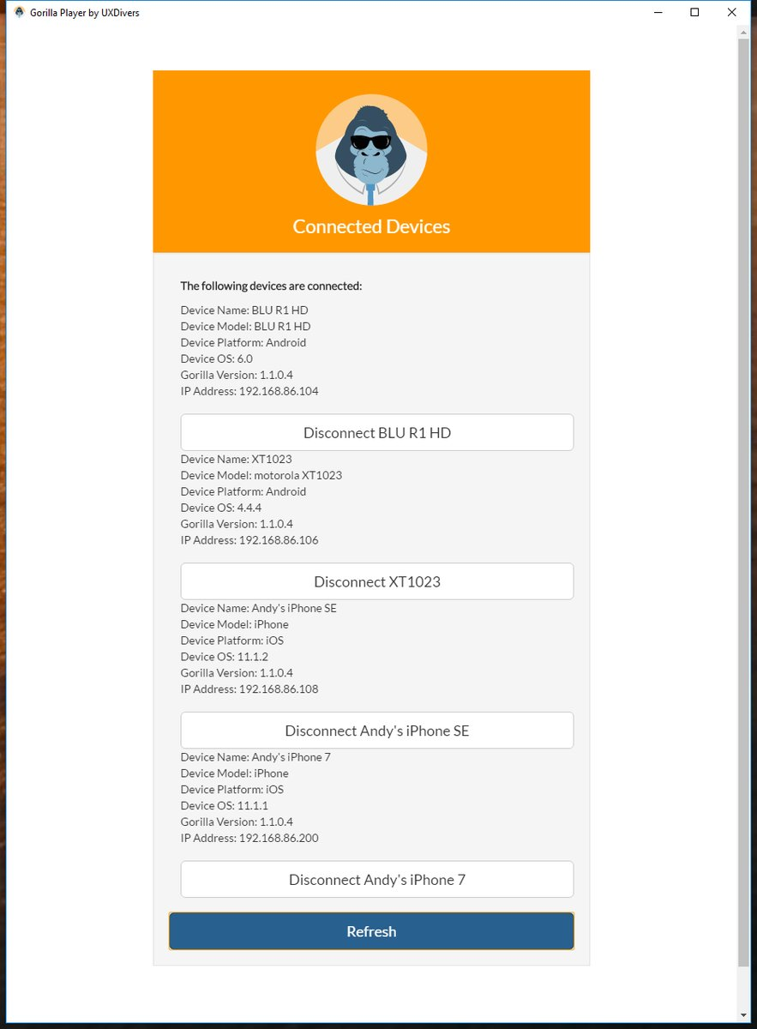
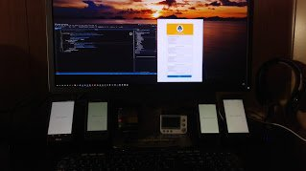
Gorilla Player
Plug-in for Visual Studio 2015, 2017
Requires Gorilla Player desktop application
Broadcasts on port to devices on same WiFi
Design-time data
No architecture changes
Data editable in JSON files
Links:
Gorilla Player
Visual Studio Extension
GitHub

